Slide 1
Data Menders Mini Intro.
Multi-factor Analysis to Reduce False Alarms in Intensive Care Units
Robert Rasmussen, Nathan Payton- McCauslin, James Todd, Alexander Grzesiak
Notes:
Multi-factor Analysis to Reduce False Alarms in Intensive Care Units

Slide 2

Fatemeh Afghah PhD.
Assistant professor at NAU
Daughter is inspiration for reducing ICU false alarms
Research
  $175,000 from the NSF to create an algorithm to analyze multiple inputs to determine alarms
  Big data analysis
  Decentralized decision making in autonomous systems
  Spectrum management
Notes:
Teachings: Has taught at North Carolina A&T State and the University of Maine in topics mostly in networks and communication systems but has also started teaching signals and systems.
Inspiration: When her daughter was born she had trouble breathing and was placed in NICU. There were dozens of times when alarms would go off and she would jump to her feet like any worried mother would only to realize that it was because her daughter shifted in the bed.

Slide 3
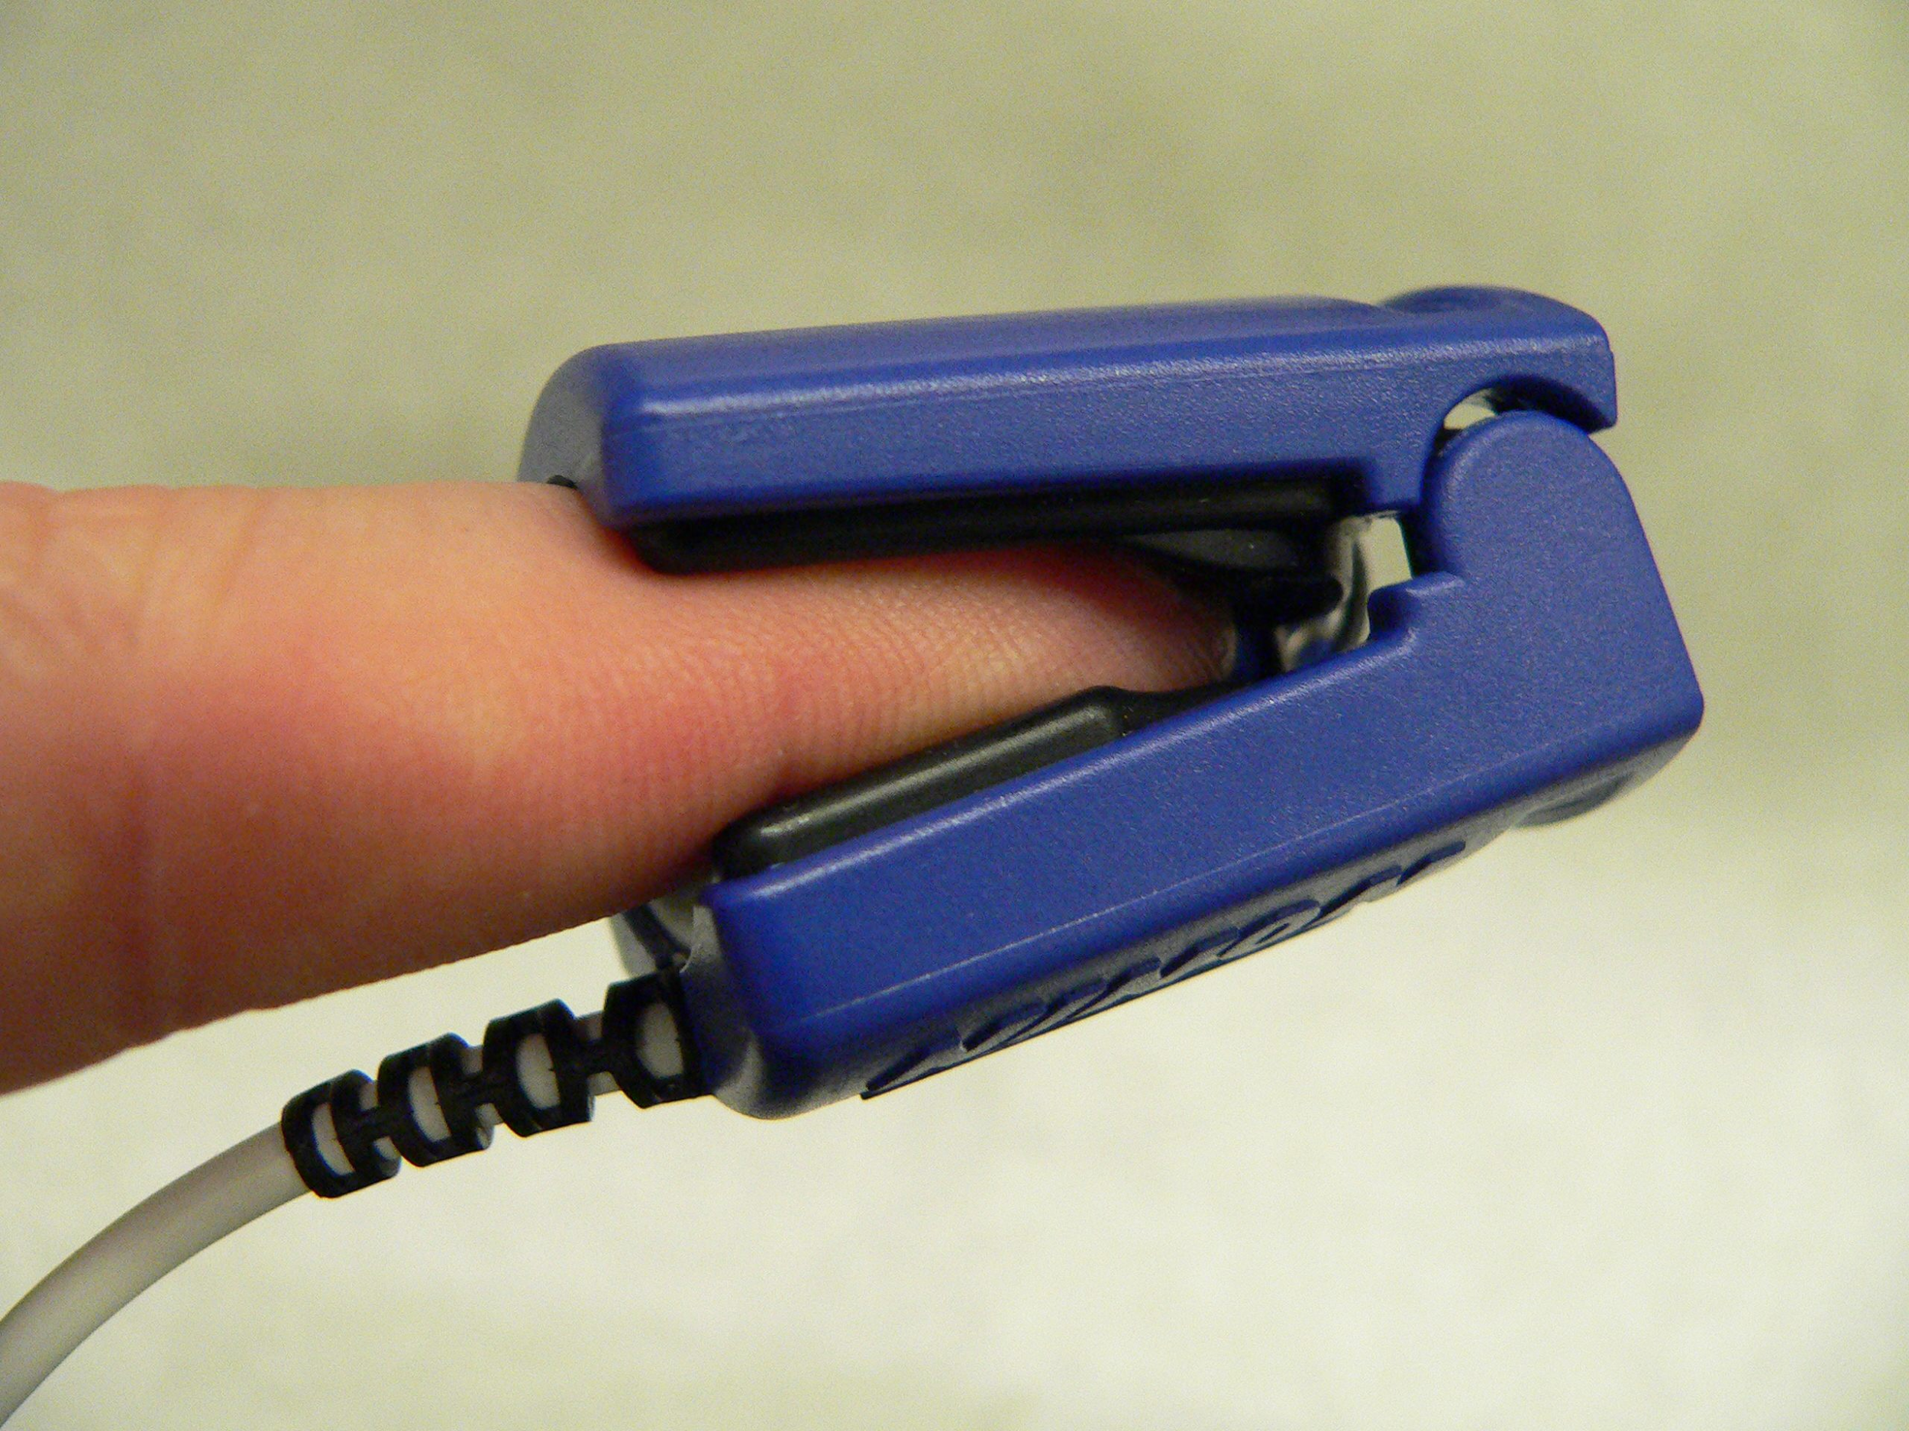
Project Overview
Analysis of false alarms in medical ICU units.
Emergency Care Research Institute (ECRI) placed false alarms at number one in the list, “Top 10 Health Technology Hazards” for the years 2012, 2013 and 2015.
The FDA database received 566 reports of patient deaths related to alarms of monitoring devices.
Notes:
Our project has to do with reducing the number of false alarms in ICU units in hospitals. False alarms are a huge problem in the medical world because of a couple reasons but mainly because they reduce nurse responsiveness by creating a “cry wolf effect.” This is to say that after a nurse has received numerous false alarms, they are more likely to not take the alarms seriously when it actually matters. This is such a big problem in fact, that the Emergency Care Research Institute place false alarms at number one on their list of the Top 10 Health Technology Hazards for the years 2012, 2013, and 2015. To better visualize the seriousness of this issue, the FDA database received 566 reports of patient deaths related to the alarms of monitoring devices. This brings us to our proposed plan to fix this issue and save lives.

Slide 4
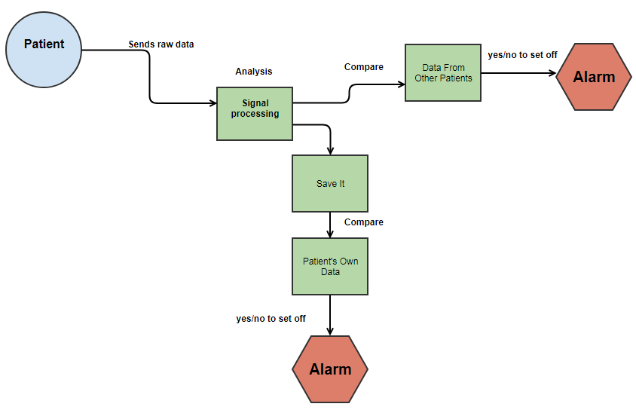
Overview

Slide 5
Signal processing
Ways to analyze “signals” - waves.
We will be using two types of signal processing:
Fourier Transforms
Wavelet

Slide 6
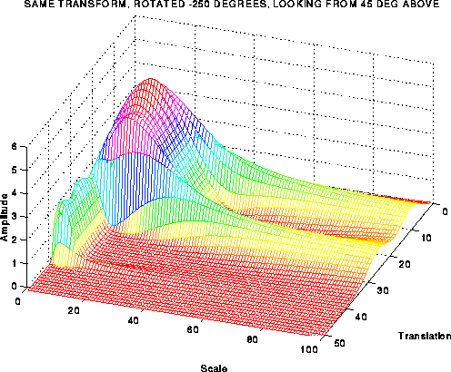
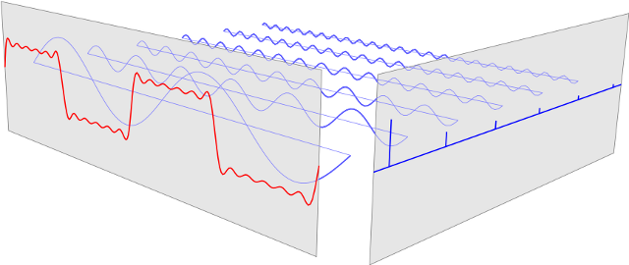
Wavelet and Fourier transforms
Fourier
Wavelet

Slide 7
To Understand Requirements
We plan on having weekly meeting with our mentor/client. Within these meetings we are talking about what we have learned over the week and what will be next to do.
Once after the mentor/client meeting our team will meet up and talk about what went down in the meeting and plan what to do next.

Slide 8
Technical Investigation
We will need to learn signal processing - specifically Fourier Transforms and Wavelet.
We will need to learn how to use Matlab to process the signals and to turn them into a more parsable format.

Slide 9
Other issues
Legal issues - How much room for error can we have? What happens if our program kills someone?
We always want to air on the side of caution so if there is even a small chance an alarm is true we want to trigger it.

Slide 10
Closing
We are hoping to drastically reduce false alarms in ICUs, thus reducing Cry Wolf Syndrome in the staff.
We will do so by utilizing Signal Processing to analyze various signals from the body to determine the cause of various issues.

